Slide 1

CAPSTONE PROJECT
DSA0216 – COMPUTER VISION WITH OPENCV
Vision-Based Early Screening and Risk Classification of Parkinson’s Disease Using Hand Tremor Analysis
Students:
B PAVAN KUMAR (192424295)
K ROOPESH REDDY (192424340)
A YUVAN CHARAN(192424383)
Guides:
Dr. SENTHILVADIVU S
Dr.KUMARAGURUBARAN T

Slide 2


ABSTRACT
Parkinson’s Disease is a progressive neurological disorder that affects body movement and often causes hand tremors in the early stages.
This project uses a real-time vision-based system that allows contactless and non-invasive screening using a normal webcam.
The MediaPipe framework is used to detect and track hand landmarks to monitor tremor movements accurately.
Important tremor features such as amplitude and dominant frequency are extracted using motion analysis and Fast Fourier Transform (FFT).
A Support Vector Machine (SVM) model is trained to classify subjects into normal or Parkinson’s risk categories based on extracted features.
Combining computer vision, signal processing, and machine learning creates an efficient, low-cost, and automated early screening system.

Slide 3


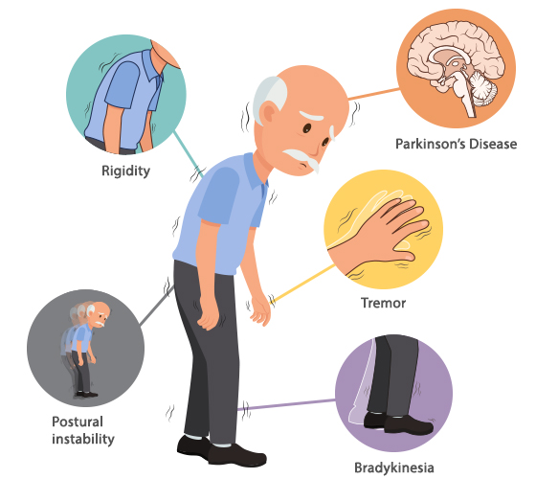
INTRODUCTION
Parkinson’s Disease is a progressive neurological disorder that affects movement and commonly causes hand tremors in early stages.
Early detection of tremor symptoms can help improve treatment planning and slow disease progression.
Vision-based analysis allows contactless and non-invasive tremor monitoring using a simple webcam.
Tremor features such as amplitude and frequency are extracted to understand movement patterns.
Machine learning using Support Vector Machine (SVM) classifies subjects into Normal and Parkinson’s Risk categories.

Slide 4
OBJECTIVE
To develop a vision-based system for detecting hand tremors using a standard camera without wearable sensors.
To implement MediaPipe-based hand landmark tracking for accurate motion capture and tremor monitoring.
To extract important tremor features such as amplitude and frequency using signal processing techniques.
To generate a structured real-time dataset by automatically storing calculated tremor parameters.
To train and apply a Support Vector Machine (SVM) model for classifying subjects into normal and Parkinson’s risk categories.
To design an efficient, low-cost, and non-invasive early screening framework for Parkinson’s disease.

Slide 5
PROBLEM STATEMENT
Parkinson’s disease causes hand tremors, especially in early stages.
Early tremors are small and difficult to detect with normal observation.
Many diagnosis methods require expensive medical equipment.
There is a need for a simple, low-cost, and non-invasive detection system using a camera.
Hand movements must be converted into numerical values like amplitude and frequency.
Noise and large voluntary movements must be removed for accurate analysis.
A machine learning model is required to classify the tremor as normal or Parkinson’s risk.

Slide 6
S.No | Title | Authors & year | Algorithm Used | Problem Addressed | Advantage | Disadvantage
1 | Wearable Sensor-Based Tremor Detection | Ahmed et al., 2020 | Accelerometer Sensors | Motion measurement using wearable devices | Accurate physical motion capture | Accurate physical motion capture
2 | ANN-Based Parkinson’s Classification | Patel & Rao, 2022 | Artificial Neural Network (ANN) | Tremor classification | High learning capability | Requires large dataset and high computation
3 | Statistical Feature-Based Tremor Analysis | Patel & Rao, 2022 | Artificial Neural Network (ANN) | Tremor classification | Simple implementation | No real-time detection and low classification accuracy
4 | Frequency Based Tremor Detection | Kumar & Singh, 2021 | FFT(Fast Fourier Transform ) | Frequency estimation | Good frequency analysis | Ignores amplitude and motion variation features
5 | Manual Clinical Tremor Assessment System | Lee et al., 2023 | Clinical Observation | Parkinson’s screening | Easy to implement | No automation and subjective human error
LITERATURE REVIEW

Slide 7

SYSTEM ARCHITTECTURE
Start Video Capture
(Webcam Input)
Hand Detection using MediaPipe
Display Results & Charts
Landmark Tracking
& Pixel Extraction
Tremor Feature Extraction
SVM-Based Risk
Classification
K-Means Clustering

Slide 8
MODULE 1: Hand Tremor Detection and Landmark Tracking using mediapipe Framework
This module focuses on detecting and tracking hand movement in real time using a webcam and the MediaPipe framework.
Video Acquisition: The system captures hand movement videos using a normal camera without requiring any wearable devices.
Hand Landmark Detection: MediaPipe identifies 21 hand key points, including wrist and finger joints, to accurately track hand position.
Continuous Tracking: Landmarks are tracked frame by frame to monitor subtle shaking and tremor movements.
Region of Interest Extraction: The hand area is isolated from the background to improve detection accuracy.
Tremor Motion Data Collection: All landmark coordinates are stored as motion data for further tremor analysis.

Slide 9
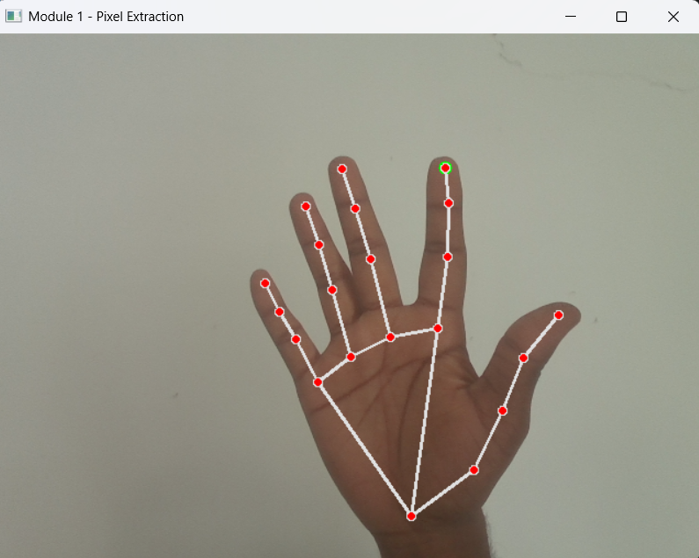
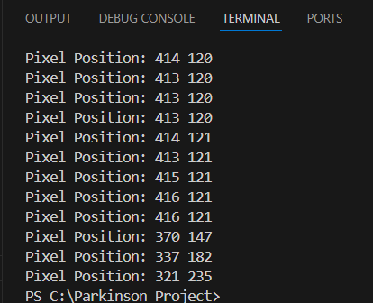
MODULE 1 : OUTPUT
PSEUDOCODE:
OUTPUT:
Start
Input: Live webcam video
Initialize MediaPipe Start camera
For each video frame: Detect hand Extract index fingertip position Convert to pixel coordinates Display pixel values
Show video with landmarks
Stop when ESC pressed
Output: Fingertip pixel coordinates
End

Slide 10
MODULE 2: Quantitative tremor feature extraction and motion pattern analysis
This module converts raw hand movement data into measurable tremor features.
Displacement Analysis: The change in hand landmark position between frames is calculated to measure tremor movement.
Amplitude Measurement: The intensity of shaking is determined using the variation in hand position.
Frequency Estimation: The system estimates tremor speed to identify abnormal repetitive oscillations.
Feature Preparation: All extracted tremor measurements are converted into numerical feature values for machine learning.

Slide 11
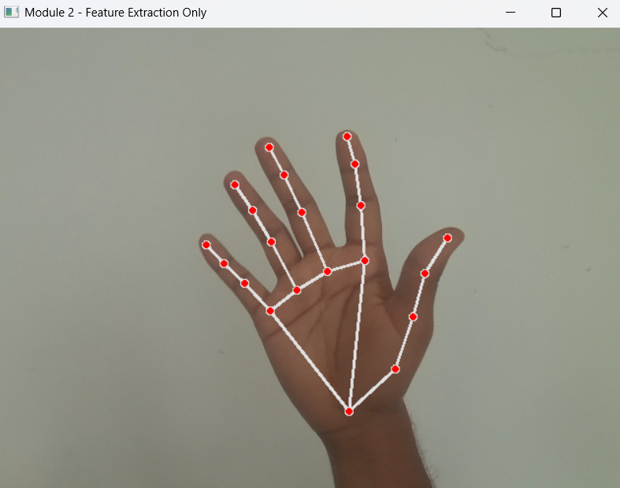
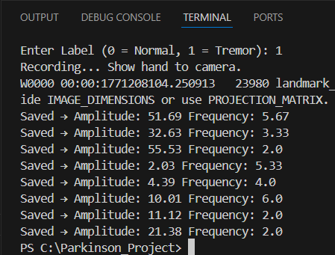
MODULE 2 : OUTPUT
PSEUDOCODE:
OUTPUT:
Input: Live video
Start camera Detect hand
For each frame: Track fingertip position Calculate movement distance Store motion data
If enough data collected: Calculate Amplitude Calculate Frequency (using FFT) Display values on screen Save values to CSV
Stop when ESC pressed
Output: Amplitude, Frequency
End

Slide 12
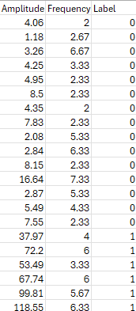
TREMOR DATASET

Slide 13
MODULE 3: Parkinson’s disease classification using support vector machine (SVM)
This module performs automated classification of tremor patterns using real-time extracted features.
Dataset Loading: The system loads the tremor dataset generated from Module 2 containing amplitude and frequency values.
Feature Scaling: Standardization is applied to amplitude and frequency values to improve model performance and stability.
SVM Model Training: The classifier is trained using labeled tremor data stored in the CSV dataset.
Real-Time Prediction: The trained model classifies new tremor feature values automatically as Normal or Parkinson’s Risk.
Graphical Representation: The system visualizes amplitude vs frequency distribution along with classification results for better analysis.

Slide 14
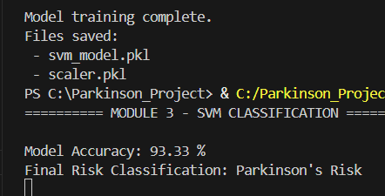
MODULE 3 : OUTPUT
PSEUDOCODE:
OUTPUT:
Start Load dataset Load trained SVM model
Scale the feature values
Predict Normal or Parkinson’s Risk Calculate model accuracy
Plot graph with decision boundary
Output: Model Accuracy Risk Classification SVM Graph
End

Slide 15
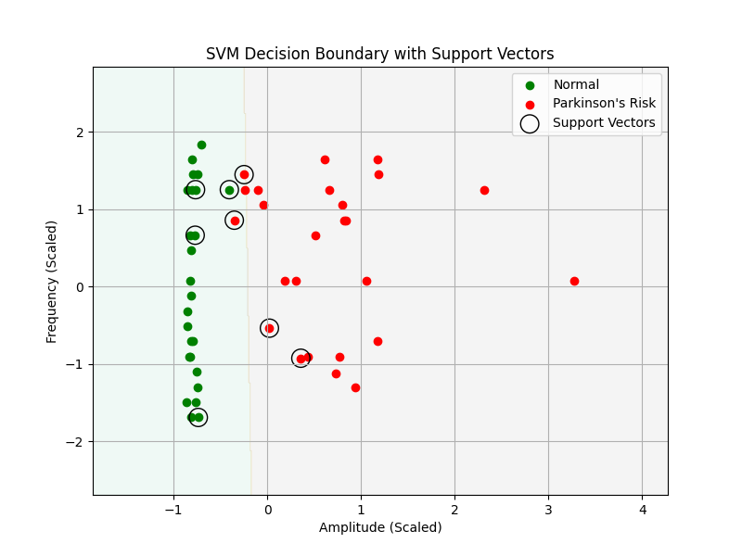
RESULT AND COMPARISON
Overall Comparison Summary
Aspect | Existing Methods | Proposed Project
Clustering Approach | Uses wearable sensors or clinical equipment | Uses webcam-based hand tracking (contactless method)
Accuracy Evaluation | Manual signal processing or limited features | Automatic tremor amplitude & frequency extraction using FFT
Handling Outliers | Basic machine learning models | Optimized SVM with clear decision boundary
Feature Usage | Mostly numerical results only | Shows model accuracy + risk classification + graphical visualization

Slide 16
CONCLUSION
The system successfully captured real-time hand tremor using MediaPipe and extracted amplitude and frequency values.
Signal filtering and FFT improved the accuracy of tremor frequency detection within the 2–8 Hz range.
The generated dataset was used to train an SVM model, which achieved good classification accuracy.
Overall, the proposed system provides a simple, low-cost, and contactless method for early Parkinson’s risk detection.

Slide 17
FUTURE SCOPE
Extend the system to larger and more diverse tremor datasets for improved SVM classification accuracy.
Integrate real-time continuous monitoring to track tremor progression over time.
Combine additional features such as hand stability index, speed variation, and spiral drawing analysis for better prediction.
Develop a user-friendly clinical application for doctors to perform quick and contactless Parkinson’s screening.

Slide 18


References
Rao, P., & Kulkarni, V. (2022). Vision-based hand tremor analysis for early Parkinson’s disease detection. International Journal of Biomedical Engineering, 18(3), 145–156.
Verma, A., & Singh, D. (2023). FFT-based tremor frequency analysis using video processing techniques. Journal of Medical Signal Processing, 27(1), 34–42.
Chen, L., Zhang, Y., & Wu, H. (2021). Support vector machine approach for Parkinson’s disease classification using motor features. IEEE Transactions on Biomedical Engineering, 68(9), 2754–2762.
Ahmed, K., & Thomas, J. (2020). Wearable sensor-based tremor quantification in Parkinson’s disease patients. Sensors and Health Monitoring Journal, 14(4), 201–210.
Gupta, R., & Nair, P. (2023). Real-time hand landmark tracking using MediaPipe for movement disorder assessment. Journal of Computer Vision in Healthcare, 9(2), 78–88.
Martinez, J., & Silva, R. (2022). Machine learning techniques for early-stage Parkinson’s disease screening. Computational Neurology Review, 11(1), 52–63.
Li, X., & Huang, M. (2021). Time-frequency analysis of pathological tremor using digital signal processing. Biomedical Signal Analysis Journal, 35(6), 415–426.
Deshmukh, S., & Patil, A. (2024). Comparative study of SVM and neural networks for Parkinson’s tremor classification. International Journal of Artificial Intelligence in Medicine, 16(2), 119–130.
Johnson, T., & Brown, E. (2022). Contactless movement disorder detection using computer vision techniques. Healthcare Informatics Research, 28(3), 233–242.
Krishnan, R., & Bose, S. (2023). Quantitative tremor amplitude and frequency measurement using camera-based systems. Journal of Medical Imaging and Diagnostics, 19(4), 301–312.

Slide 19
THANK YOU!

